Slide 1

“Global Trends in Coffee: A Comprehensive Analysis of Imports, Exports, and Consumption Patterns Across Countries (1990-2020)”
Ceara Stewart – 6/9/2023
IST652 Final Project – Debbie Landowski – Syracuse University

Slide 2

Agenda
Introduction
Data and its Source
Analysis Questions
“Do countries consume more of the coffee they specialize in producing?”
“Is there a difference in coffee amounts between what is produced and or imported versus what is consumed? And is this amount equal to what is exported or re-exported?”
“Is there a pattern of an increase or decrease in coffee consumption over the years? And does green coffee investment follow this pattern?”
Conclusion

Slide 3

Introduction
Coffee is the second most consumed beverage globally. And like most of the population, I don’t go a single morning without brewing myself a cup of coffee. But most people aren’t fully aware with the production, global consumption and exportation of coffee.
This presentation aims to provide an analysis of coffee imports, exports, and consumption from 1990 to 2020.
I will be presenting findings related to three posed questions:
“Do countries consume more of the coffee they specialize in producing?”
“Is there a difference in coffee amounts between what is produced and or imported versus what is consumed? And is this amount equal to what is exported or re-exported?”
“Is there a pattern of an increase or decrease in coffee consumption over the years? And does green coffee investment follow this pattern?”

Slide 4
Data and its Source
Kaggle
Site containing compiled data sets for public use.
International Coffee Organization
Intergovernmental organization for coffee
United Nations Development Program
Organization aimed at helping developing nations achieve growth
Date Sets
Coffee_domestic_consumption.csv
Coffee producing counties and their coffee consumption amount and coffee type
Coffee_exports.csv
Coffee amounts exports from producing countries
Coffee_green_coffee_inventorie.csv
Coffee amounts that are held by green coffee investing countries
Coffee_imports.csv
Coffee amounts imported into non-producing countries
Coffee_impoters_consumption.csv
Coffee amount consumed by non-producing countries
Coffee_production.csv
Coffee amounts produced by countries and the coffee type produced
Coffee_re_exportation.csv
Coffee amounts re-exported by non-producing countries

Slide 5
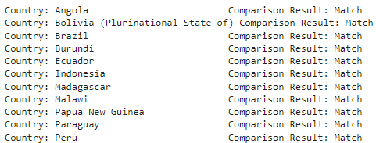
Question 1: “Do countries consume more of the coffee they specialize in producing?”
Analyzes producing countries and their consumption, comparing coffee types Arabica and Robusta.
After joining the coffee production and domestic consumption data frames and running a comparison on coffee type, each country produced a “Match”.
All producing countries do consume the same coffee type that they produce.
This aligns with economic theories as consuming domestically made products is cheaper than importing products. This leads to more consuming money that can be put back into the economy.

Slide 6
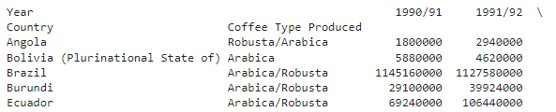
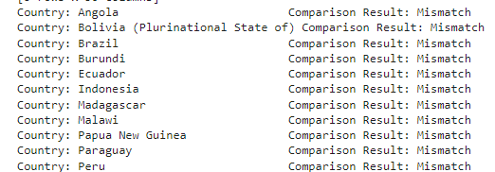
Question 2: “Is there a difference in coffee amounts between what is produced and or imported versus what is consumed? And is this amount equal to what is exported or re-exported?”
Analyzed the differences between what was produced and domestically consumed and compared that to what was exported.
For producing countries, each country resulted in a “Mismatch”.
After domestic consumption and then exportation, there is still coffee left over.

Slide 7

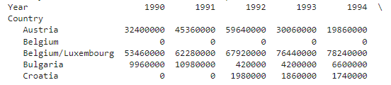
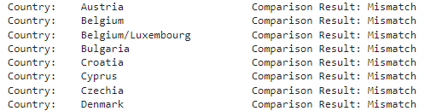
Question 2: Continued
Analyzed the differences between what was produced and domestically consumed and compared that to what was exported.
After importer nation consumption and then re-exportation, there is still coffee left over.
For importing countries, each country resulted in a “Mismatch”.
Syracuse University – IST 652

Slide 8
Question 2: Continued
After domestic consumption, exportation and importation, importer nation consumption, and re-exportation, there is still coffee left over from what was originally produced.
Coffee is only good for 3-5 months if grounded, and 6-9 months if left as the whole bean.
Left over coffee is a contributor of greenhouse gas emissions as it breaks down in landfills.
Countries, organizations and businesses are trying to reduce coffee waste by turning left over coffee into raw materials and eco-products.

Slide 9
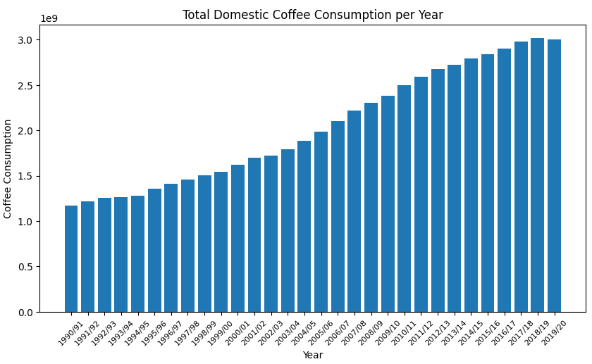
Question 3: “Is there a pattern of an increase or decrease in coffee consumption over the years? And does green coffee investment follow this pattern?”
The first graph looks at the domestic country coffee consumption summed over the years 1990-2020.
There is a logistic increase in domestic coffee consumption over the years.
The nature of the graph suggests that producing countries started to gain access to more resources in the 1990’s, allowing for more coffee production and subsequent coffee consumption.
There is a slight uncharacteristic drop in 2019/2020, which could suggest a pattern of decrease in consumption, possibly a result of the Covid-19 pandemic.

Slide 10
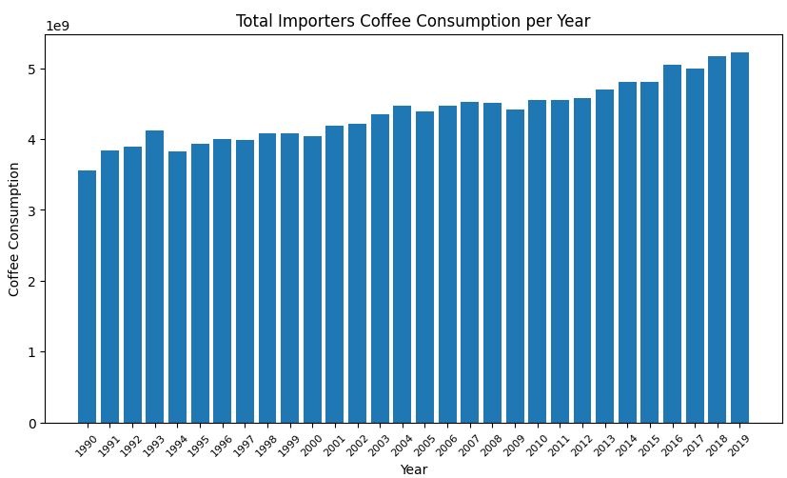
Question 3: Continued
The second graph looks at the importer country coffee consumption summed over the years 1990-2019.
There is an overall shallow increase, with areas of decrease.
The nature of the graph aligns with historical and economic markers.
The drop in consumption in 1994 aligns with the signing of NAFTA. The drop in 2000 aligns with Y2K. And the drop in 2009 aligns with the housing market crash of late 2008.

Slide 11
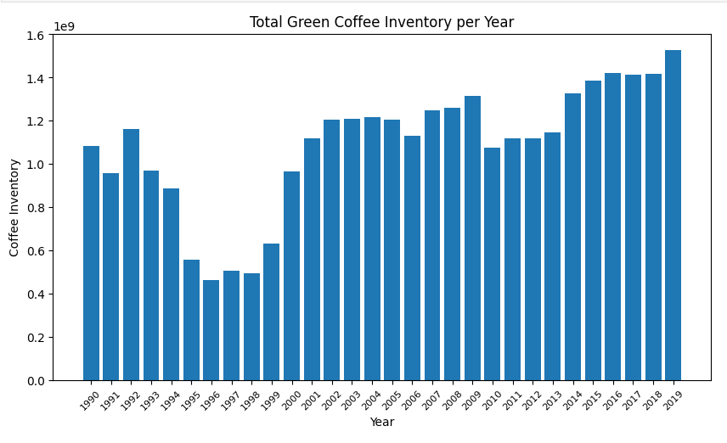
Question 3: Continued
The third graph looks at green coffee inventory amounts summed over the years 1990-2019.
There is a general increase from 1990 to 2019, but a lot of drastic drops and rises.
Green coffee is unroasted, raw coffee beans. Its extract is popular in many dietary supplements.
The drops in green coffee inventory aligns with investment drops. As green coffee is more prone to market changes than normal coffee for everyday consumption.

Slide 12
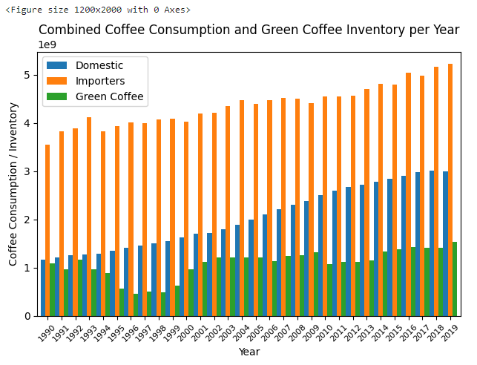
Question 3: Continued
The fourth graph is the layering of the previous three graph from the years 1990-2019.
Importing country consumption is double that of producing country consumption.
Importer country consumption and green coffee inventory are more prone to market fluctuations, but green coffee takes longer to recover.
Overall, each graph follows economic and historical market patters you would expect to see in developed and developing countries.

Slide 13


Conclusion
Countries consume more of the coffee type they specialize in producing.
After production, exportation and consumption, there is still coffee left over.
Coffee consumption and green coffee inventory have increased from 1990-2020 and can be hindered by economic and historical occurrences.

Slide 14

Source Links
https://www.kaggle.com/datasets/michals22/coffee-dataset​
https://www.undp.org/moldova/news/what-can-we-do-leftover-coffee-moldovan-and-polish-companies-partner-upcycle-spent-coffee-grounds
https://timesofindia.indiatimes.com/life-style/food-news/5-smart-ways-to-use-your-leftover-coffee-grounds/photostory/93970103.cms?picid=93970431
Learning Lessons From the 1990s: Long-Term Growth Prospects for the U.S. | Economic Policy Institute (epi.org)

